Slide 1





MEDICAL IMAGEING ANLAYSIS
Name: mohamed rishwan.s Guide: P.Raja,Master Trainer
NM-ID: au923821114017
E-Mail ID:mohamedrishwan236@gmail.com
Disclaimer: The content is curated for educational purposes only.
Notes:
Slides: Prepare a short slide deck (10-12 slides) summarizing the project objectives, methodology, and key results.

Slide 2
OUTLINE
Abstract of the Project
Problem Statement
Proposed Solution
System Architecture
Live Demo of the Project
Embedded Video of Project
Conclusion
Future Scope

Slide 3
Abstract
Medical imaging analysis is a critical component of modern healthcare, enabling accurate diagnosis, treatment planning, and disease monitoring. Advances in imaging modalities such as X-ray, CT, MRI, ultrasound, and PET have revolutionized the detection and management of a wide range of medical conditions.The integration of machine learning, deep learning, and computer vision techniques into medical imaging has significantly enhanced the ability to automate image interpretation, identify subtle patterns, and assist clinicians in making more informed decisions.

Slide 4
Problem Statement
In the field of medical imaging, efficient and accurate analysis of medical imagesiscritical for diagnosing and monitoring diseases. The problem at hand is to develop an automated system that can analyze medical imaging data (such as X-rays, CT scans, MRI, or ultrasound images) to detect, classify, and segment abnormalities like tumors, lesions, fractures, or other pathological conditions. This system must assist healthcare professionals by providing insights that complement their expertise, enhance diagnostic accuracy, and improve patient outcomes.

Slide 5
Proposed Solution
A proposed methodology for medical imaging analysis could follow these stages, leveraging deep learning, data preprocessing, and model optimization to achieve accurate, reliable results:
Data Collection and Preparation
Data Augmentation
Model Selection
Model Training and Optimization

Slide 6
System Architecture
Here’s a detailed system architecture for an AI-based medical imaging analysis solution:
Data Acquisition Layer
Data Preprocessing Layer
AI Model Layer
Integration and Communication Layer
User Interface Layer

Slide 7
Live Demo of Project

Slide 8
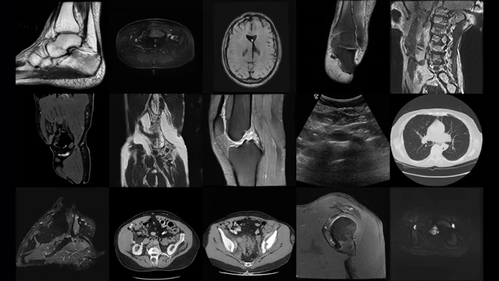
Video of Project Demo

Slide 9
Conclusion
The integration of AI-driven medical imaging analysis systems is poised to revolutionize healthcare by enabling faster, more accurate diagnoses, reducing clinician workloads, and improving patient care. The discussed recommendation system framework, based on deep learning models and robust preprocessing techniques, provides a pathway to achieving these goals. However, it is essential to address challenges related to data quality, model interpretability, class imbalance, privacy concerns, and generalization across healthcare institutions.

Slide 10
Future Scope
AI algorithms are increasingly capable of analyzing medical images such as X-rays, CT scans, MRI scans, and ultrasound images with high precision. They assist in detecting abnormalities, classifying diseases, and predicting patient outcomes, thereby supporting clinicians in making informed decisions. For instance, AI has demonstrated superior accuracy in identifying certain cancers compared to human radiologists. ​​AI facilitates the segmentation of anatomical structures and lesions, enabling precise measurements and assessments. This automation aids in monitoring disease progression and evaluating treatment responses, reducing the manual workload for radiologists.The creation of extensive, annotated medical image datasets is crucial for training robust AI models. Initiatives to compile and share such datasets are underway, aiming to improve the generalizability and reliability of AI applications in diverse clinical settings. ​​ ​​

Slide 11
Thank you!
Notes:
thank you very much for joining this PPT, keep learning.

